Slide 1
Human Innovation
& Artificial Intelligence
Luca Fallica
Head Program Mgmt & Digital Innovation
Turin, January 26th 2024

Slide 2
Megatrends

Slide 3
MACROTRENDS driving business Transformation
Green Transition
Economic Outlook
New Technologies
People
New Environment, Social and Governance standards
investing into sustainable transition
New generation
Uncertain future
skill shifting
Focus on work-life balance
Supply shortages
Slower Global economic Growth
Increased adoption of new and frontier technologies
Broadening Digital Access
23%
44%
of worker’s core skills are expected to change
of today’s jobs
will change
Source: World Economic Forum, Future of Job Survey 2023.
Notes:
cambio tecnologici, cambio generazionali, cambi ambientali (nuovo purpose, più legato al benessere, alla sostenibilità e alla crescita personale, non solo ai soldi)

Slide 4
MACROTRENDS driving business Transformation
Green Transition
Economic Outlook
New Technologies
People
New Environment, Social and Governance standards
investing into sustainable transition
New generation
Uncertain future
skill shifting
Focus on work-life balance
Supply shortages
Slower Global economic Growth
Increased adoption of new and frontier technologies
Broadening Digital Access
23%
44%
of worker’s core skills are expected to change
of today’s jobs
will change
Source: World Economic Forum, Future of Job Survey 2023.
Notes:
cambio tecnologici, cambio generazionali, cambi ambientali (nuovo purpose, più legato al benessere, alla sostenibilità e alla crescita personale, non solo ai soldi)

Slide 5
Generative AI
Supercharge the productivity
across media, work, and other daily habits
Paradigm shifts
across content creation, people and enterprise

Slide 6
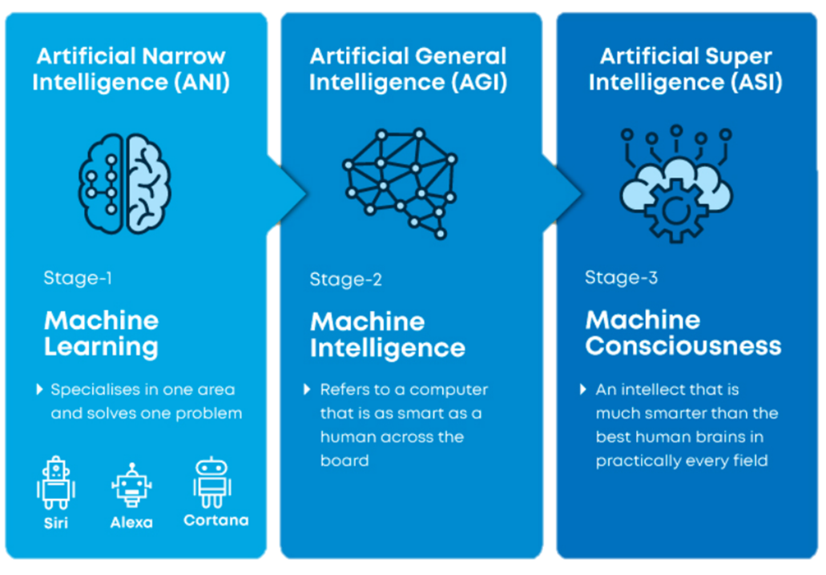
Artificial Intelligence
Notes:
1997: IBM’s Deep Blue : beats the world chess champion Garry Casparov
2016: Google DeepMind :beats the world GO champion Lee Sedol (in 2017 vs. Ke Jie)
(sintesi slide successiva) Tema etico + capacità espanse ai ruoli da colletti bianchi, non più basata su una serie di intenti e di training massivo dell’AI ma un concetto di UNSUPERVISED learning in grado di generare NUOVI contenuti basati sul dato e non su regole/intenti predefeniti

Slide 7
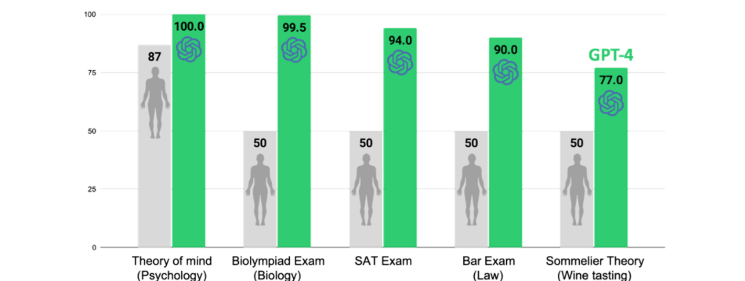
GPT-4 vs. Human Test
Selected highlights only. Percentiles; 50 refers to the 50th percentile as average, and may not be the testing average for some tests.
Alan D. Thompson. may 2023. https://lifearchitect.ai/iq-testing-ai/
Notes:
Lo SAT - Scholastic Assessment Test - consiste principalmente di tre sezioni: Critical Reading, Mathematics e Writing (rispettivamente lettura critica, matematica e scrittura).
In law, the bar is the legal profession as an institution
Massive Language Models (MLM) like GPT have made a significant impact in the field of natural language processing (NLP). Tools such as ChatGPT utilize these models to generate coherent and contextually relevant responses. These models are trained on large volumes of data and are then fine-tuned on specific datasets to improve their performance in particular tasks.

Slide 8
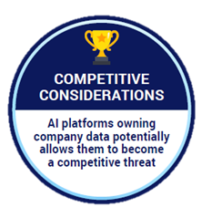
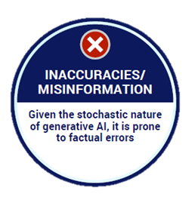
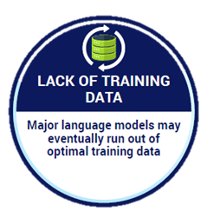
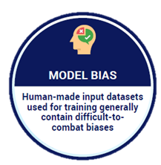
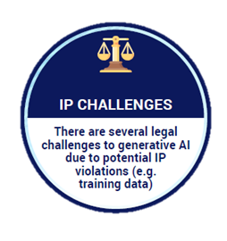
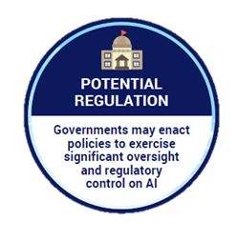
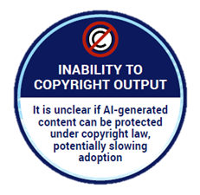
Barriers to realizing the full market potential of
Generative AI
Sources: Activation analysis
Notes:
stocastico: lo stesso di casuale e aleatorio. Per estensione, nel linguaggio scientifico, si dice di strumento, procedimento, teoria, modello atti a descrivere e studiare situazioni che variano in base a leggi probabilistiche (e non deterministiche), come, per es., tutti i fenomeni naturali.
accennare EU ACT e regolamenti internazionali

Slide 9
Roles and Skills

Slide 10
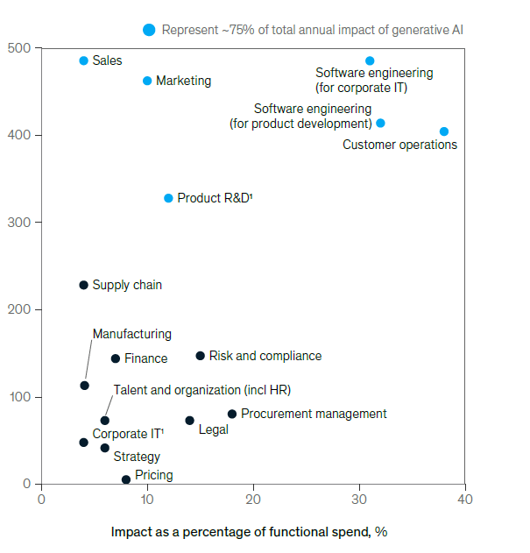
Using generative AI in few functions could drive most of the technology’s
impact across potential corporate use cases.
Sales
Marketing
Software Engineering
Customer Operations
Product R&D
Note: Impact is averaged.
¹Excluding software engineering.
Source: Comparative Industry Service (CIS), IHS Markit; Oxford Economics; McKinsey Corporate and Business Functions database; McKinsey Manufacturing
and Supply Chain 360; McKinsey Sales Navigator; Ignite, a McKinsey database; McKinsey analysis
Notes:
Differenza tra AI e AI gen.
Impatto sul lavoro non solo per i lavori a basso valore aggiunto ma anche per i professionals che possono adesso beneficiare di automatismi a valore aggiunto prima impensabili.
The economic potential of generative AI
The next productivity frontier

Slide 11
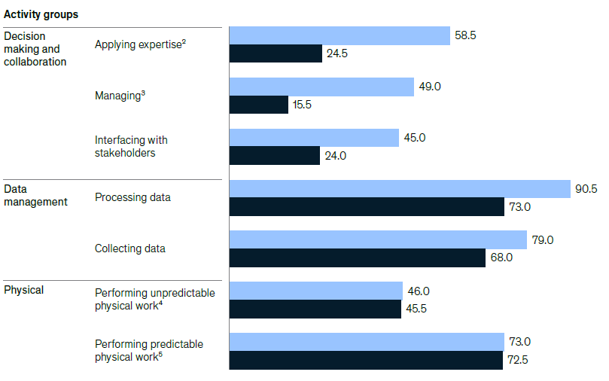
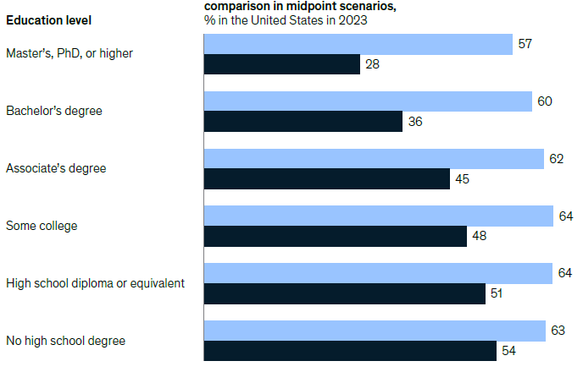
Impact of Generative AI automation on
expertise activities
higher educational levels
Notes:
educational attainment = conseguimento scolastico

Slide 12
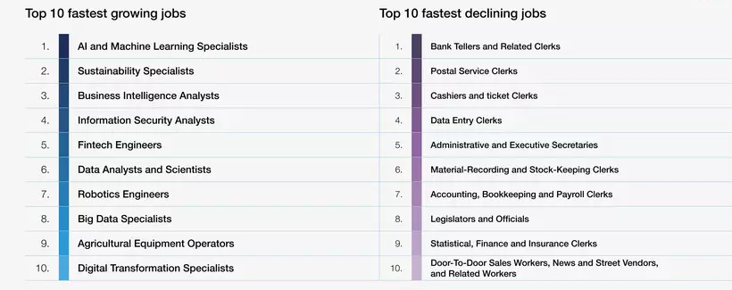
TOP 10 fastest-changing roles
Source: World Economic Forum, Future of Job Survey 2023.
The fastest-growing roles are tech/digital driven by Artificial Intelligence, Sustainability, Business Intelligence, Security, Blockchain, RPA
The fastest-declining roles are expected in
administrative roles and in traditional, security, factory and commerce roles.

Slide 13
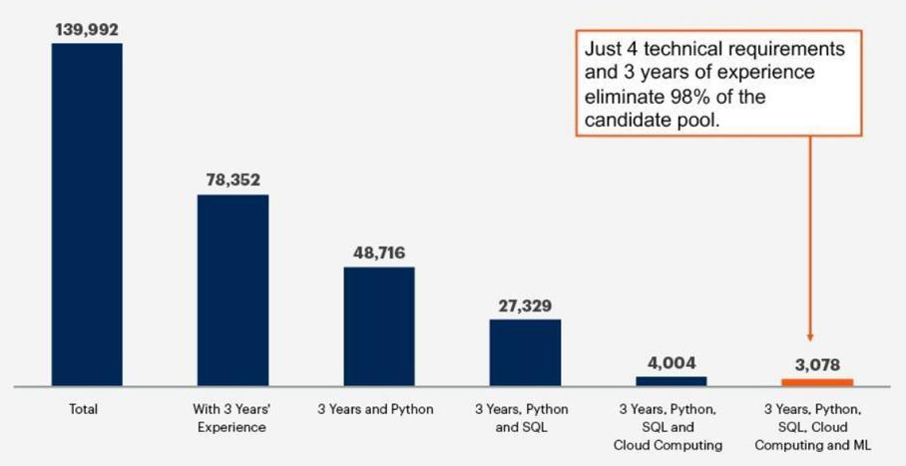
AI Talent hard to find
Technical Skills
Seniority
Notes:
Gartner for Finance
Identify and attract the next generation of finance talent.
The AI Talent Guide

Slide 14
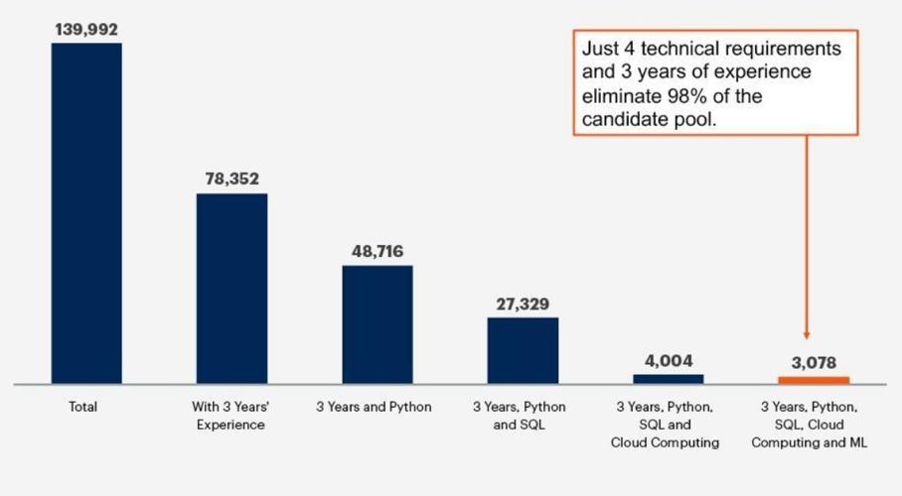
AI Talent hard to find
junior data talent searches should emphasize soft skills
while training on hard skills
senior data experts to be retained acting as
the new trainers (on the job)
Technical Skills
Seniority

Slide 15
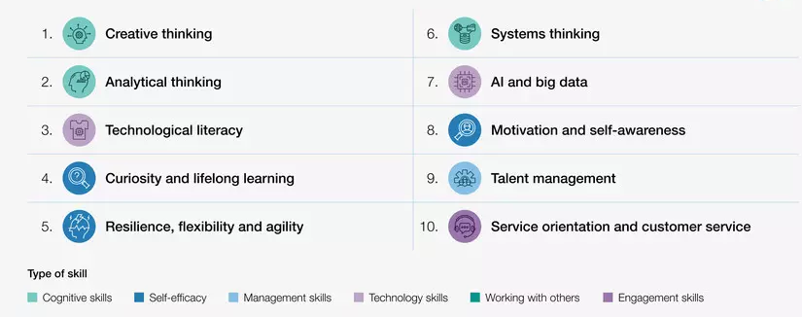
TOP 10 Skills on the rise
Analytical & Creative thinking for workers are the most important skills for workers
Top Self-efficacy Skills
Recognition of the importance
of workers ability to adapt to disrupted workplaces.
Source: World Economic Forum, Future of Job Survey 2023.

Slide 16
Talent Space

Slide 17
Talent Space : a Human Innovation Lab
Reshape Skills & Competencies
Easy Access
Continuous Learning by doing
Quick Experiment with POC/Pilot
No hard skills required
Limited/no tech requirements
Cloud-based solution
Low code/no code
Fast scale up
Alignment with HR-tech trends
Training on the digital job
Overcome tech “speed of light” frustration
Quick solutions and actions
Human
Centric
Focus on Momentum
Open Innovation
Explore new technologies
and trends
innovation focussed on fostering positive impacts on humanity
Leverage a powerful community
Web3, NFT & metaverse
AI & RPA
Sustainability, D&I
Wellbeing
Digital skill assessment
- HR expertises mixed up with tech champions
- New digital ecosystem and opportunities
- Partnering with with vertical startup, scaleup
- Randstad properties and wide involvement
Notes:
Advisory Services…. vedi note

Slide 18
New Purpose
Purpose & Ethics
New Technologies
People
Skills & Experiences
New Experiences
New Technologies
Notes:
New Purpose
New Technolgies
New Talent Experience for employee and new hiring

Slide 19
thank
you.

Slide 20
Human Innovation
& Artificial Intelligence
Luca Fallica
Head Program Mgmt & Digital Innovation
Turin, January 26th 2024

